Slide 1
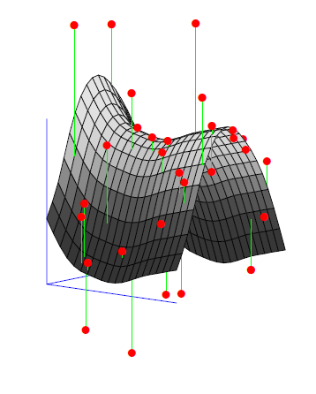
Regression, classification, Machine learning, Data mining, Optimization, pattern recognition, inverse problem-Whatever you would like to call it

Slide 2
References
Books:
Easy
Statistics for Engineers and Scientists - Wiliam Navidi
- Lots of pen and paper practices
Introduction to Multivariate Statistical Analysis in Chemometric - Kurt Varmuza
Covers, PCA, PLSR, Bayesian, NN,…with almost no math!
There is a R package called chemometric associated with book
An Introduction to Statistical Learning: with Applications in R - Gareth James
Good amount of math, topics are well introduced much easier than the below book!
All methods were implemented in R
The Elements of Statistical Learning: Data Mining, Inference, and Prediction, Second Edition
Very similar to the above book with heavy math
More of discussing the methods in terms of prose and cons
Hard

Slide 3
Bias–variance
Bias–variance tradeoff
Almost the difference between ALL METHODS is based on how do they deal with bias and variance!
In statistics and machine learning, the bias–variance tradeoff (or dilemma) is the problem of simultaneously minimizing two sources of error that prevent supervised learning algorithms from generalizing beyond their training set
The bias is an error from erroneous assumptions in the learning algorithm. High bias can cause an algorithm to miss the relevant relations between features and target outputs (underfitting).
The variance is an error from sensitivity to small fluctuations in the training set. High variance can cause an algorithm to model the random noise in the training data, rather than the intended outputs (overfitting).

Slide 4
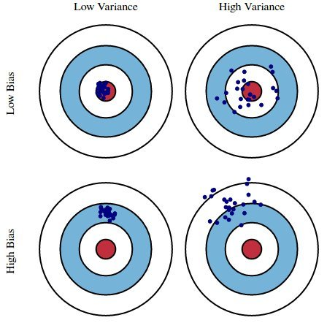

Bias–variance
What is Bias–variance tradeoff ?
This is error; we want to minimize that
Random noise
Can’t do anything about it
$$E\left[{\left(y−\hat{f}\left(x\right)\right)}^{2}\right]=Bias{ [\hat{f}\left(x\right)]}^{2}+Var \left[\hat{f}\left(x\right)\right]+σ^{2}$$
Error has two parts, Bias and variance.
- We want them both to be minimum, but its impossible there is a trade off between these two

Slide 5
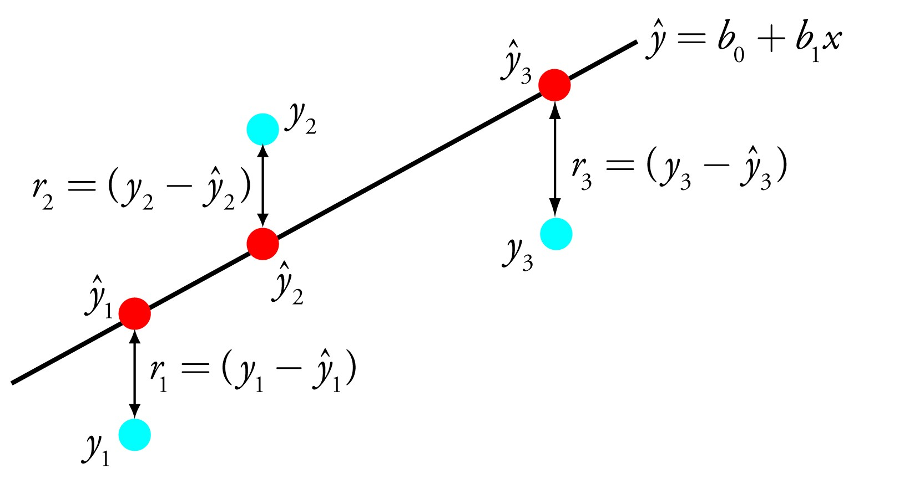
Linear methods for regression
Linear methods for regression

Slide 6
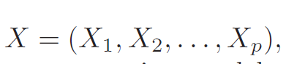
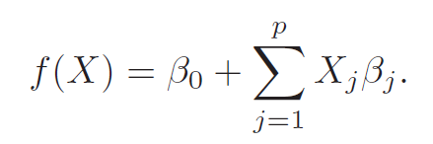
Linear methods for regression – Least square the simplest approach
Predictors
Model
Main assumption: the regression function, E(Y|X), is linear in parameters.
Sources of X
• quantitative inputs;
• transformations of quantitative inputs, such as log, square-root or square;
• basis expansions, such as X= X^{2;3..} leading to a polynomial representation;
• numeric or “dummy” coding of the levels of qualitative inputs
• interactions between variables, for example, X3 = X1 · X2.

Slide 7
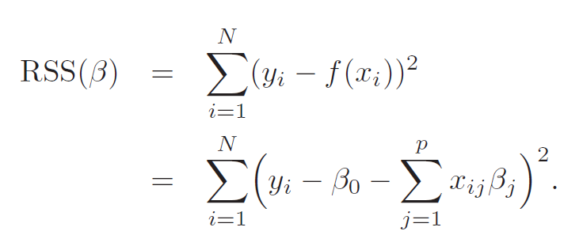
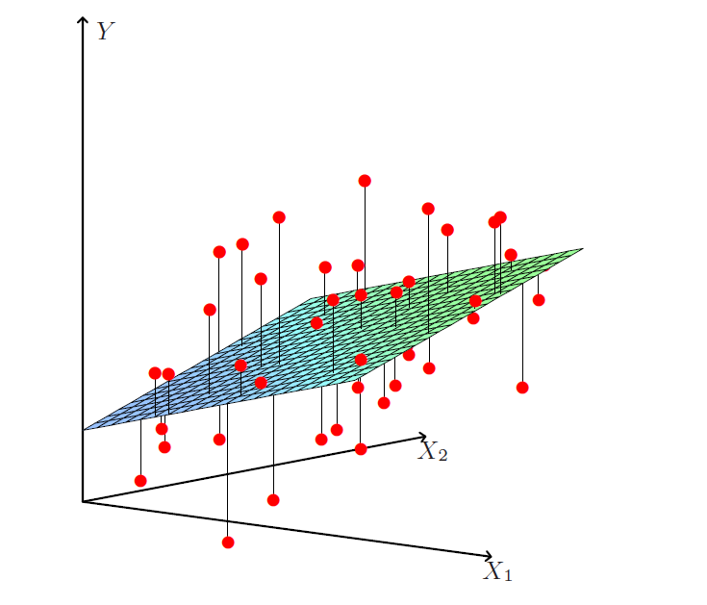
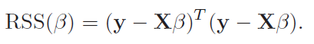
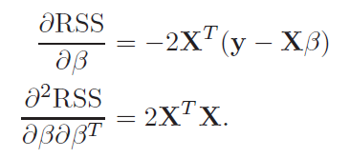
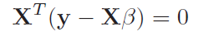
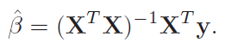
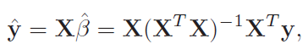
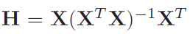
Linear methods for regression – Least square the simplest approach
Solution: We optimize for the B by minimizing the residual sum of squares (RSS) function
(X^{T}X)⁻¹ should be full column ranked (linearly independent columns). If not the matrix called singular
Hat matrix
Notes:
RSS has no assumption on the validity of the model.
B is the parameter set of the hyperplane of solution.
T

Slide 8
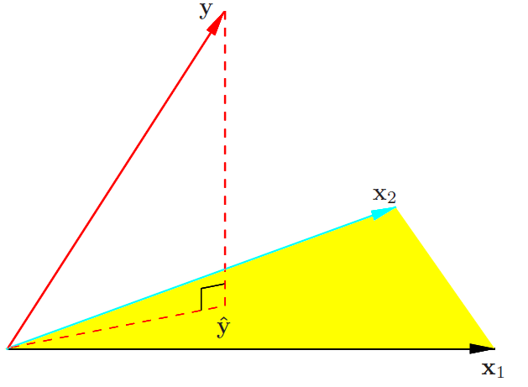
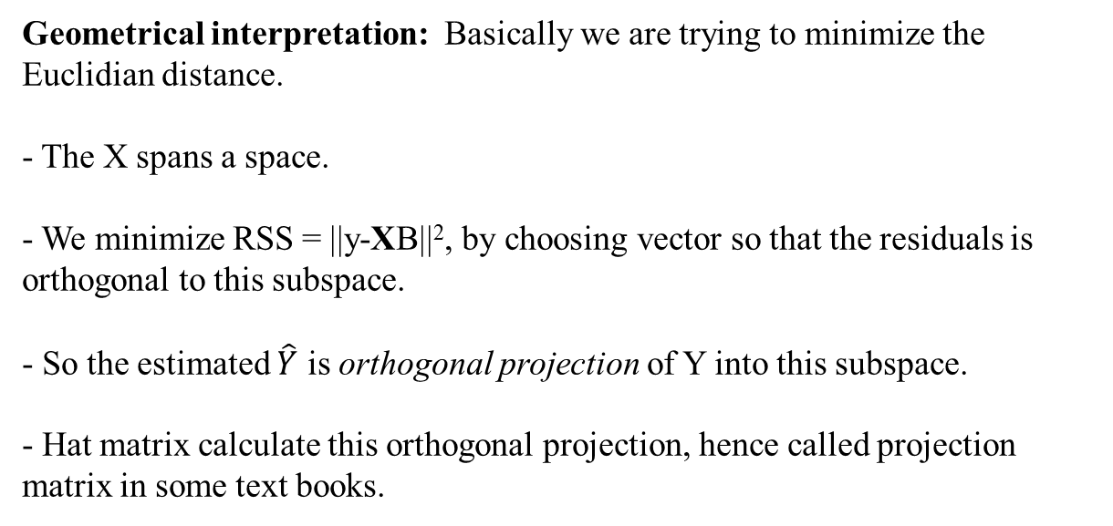
Linear methods for regression – Least square the simplest approach
Geometrical interpretation: Basically we are trying to minimize the Euclidian distance.
- The X spans a space.
- We minimize RSS = ||y-XB||², by choosing vector so that the residuals is orthogonal to this subspace.
- So the estimated $\hat{Y}$ is orthogonal projection of Y into this subspace.
- Hat matrix calculate this orthogonal projection, hence called projection matrix in some text books.
Main concern: if the (X^{T}X) is singular which means the inverse does not exist, thus the solution is not unique.
Non-full rank matrix
Dependent variables, e.g. X₁=2X₂ (be careful about VIs!)
Number of predictors are more than observation (Hyperspectral).
Solutions
Filtering method (remove redundant columns)
Regularization (later)

Slide 9
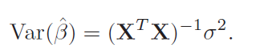
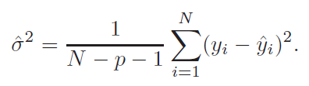
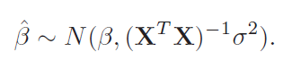
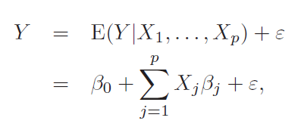
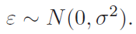
Linear methods for regression – Least square the simplest approach
Draw inferences about the parameters:
Var-Cov matrix
Assume the linear model is correct and also the deviation of Y around its expectation, E(Y|X), are additive and Gaussian.
This is a multivariate normal distribution with mean vector and variance–covariance matrix as shown.
We use these distributional properties to form tests of hypothesis and confidence intervals for the parameters B.

Slide 10
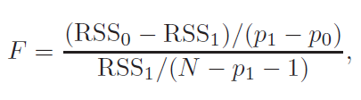
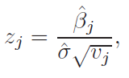
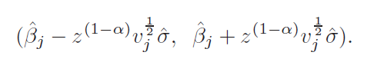
Linear methods for regression – Least square the simplest approach
We can use F test or ANOVA to compare two set of parameters…
Hypothesize tests:
Null hypothesize; B_{j} = 0 ?
Z_{j} has a t distribution with (N-p-1 degree of freedom)
Z score can be used to filter non-significant variables.
Z score and p-value tell the same story.
Confidence interval
Notes:
Z score is normalized by the polulation std, while t score is sample std
Z and t scores are the same with large population (central mean theorem);
F stats is to compare the variance of two populations.
Z scores are measures of standard deviation. For example, if a tool returns a Z score of +2.5 it is interpreted as "+2.5 standard deviations away from the mean". P-values are probabilities.
Very high or a very low (negative) Z scores, associated with very small p-values, are found in the tails of the normal distribution. When you perform a feature pattern analysis and it yields small p-values and either a very high or a very low (negative) Z score, this indicates it is very UNLIKELY that the observed pattern is some version of the theoretical spatial random pattern represented by your null hypothesis.
To give an example: the critical Z score values when using a 95% confidence level are -1.96 and +1.96 standard deviations. The p-value associated with a 95% confidence level is 0.05. If your Z score is between -1.96 and +1.96, your p-value will be larger than 0.05, and you cannot reject your null hypothsis; the pattern exhibited is a pattern that could very likely be one version of a random pattern.

Slide 11
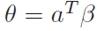
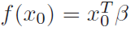
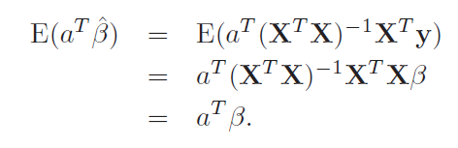
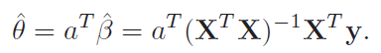
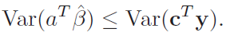
Linear methods for regression – Least square the simplest approach
The Gauss–Markov Theorem: Why linear models have the minimum variance? Is it always wise to go for small variance methods?
We focus on the estimation of any parameters combination:
Theorem:
e.g.

Slide 12
Linear methods for regression – Least square the simplest approach
The Gauss–Markov Theorem (Bias –Variance trade off)
- The Gauss-Markov theorem implies that the least squares estimator has the smallest mean squared error of all linear estimators with no bias. But it have a very high variance. There may well exist a biased estimator with smaller mean squared error. Such an estimator would trade a little bias for a larger reduction in variance.
- Biased estimates are commonly used. Any method that shrinks or sets to zero some of the least squares coefficients may result in a biased estimate.
- We discuss many examples, including variable subset selection and ridge regression, later under linear regression section.
- From a more pragmatic point of view, most models are distortions of the truth, and hence are biased; picking the right model amounts to creating the right balance between bias and variance.

Slide 13
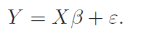
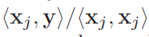
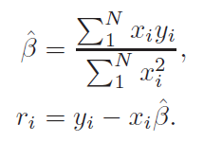
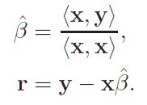
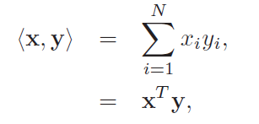
Linear methods for regression – Least square the simplest approach
Multiple Regression from Simple Univariate Regression
Suppose next that the inputs x1, x2, . . . , xp (the columns of the data matrix X are orthogonal; that is <xj , xk >= 0 for all j ≠ k. Then it is easy to check that the multiple least squares estimates are equal to :
Consider univariate case (p=1)
In other words, when the inputs are orthogonal, they have no effect on each other’s parameter estimates in the model. But that will NEVER happen! We have to enforce orthogonality.

Slide 14
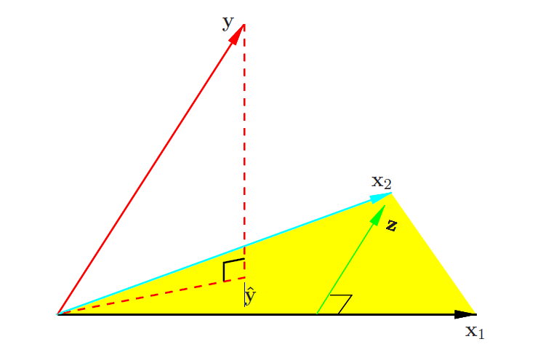
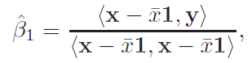
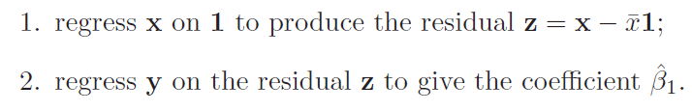
Linear methods for regression – Least square the simplest approach
Multiple Regression from Simple Univariate Regression
Suppose next that we have an intercept and a single input x. Then the least squares coefficient of x has the form:
Step 1 is orthogonalization
Step 2 is normal regression on orthogonalized residuals

Slide 15
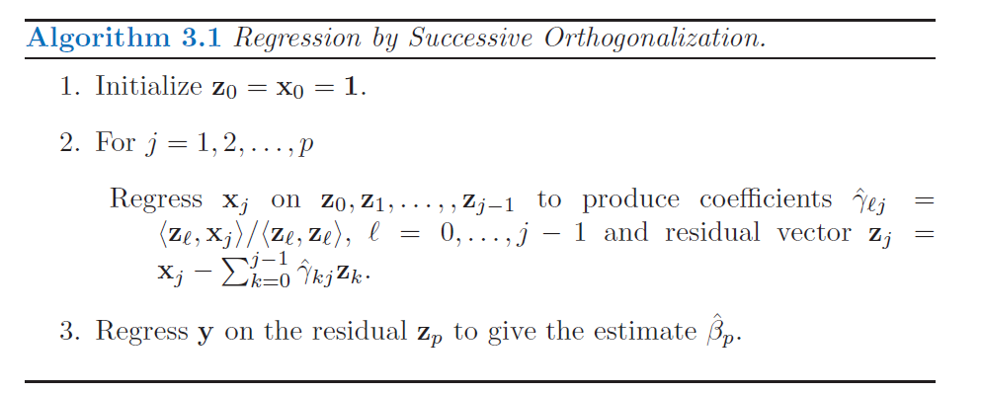
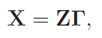
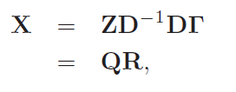
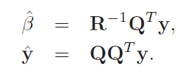
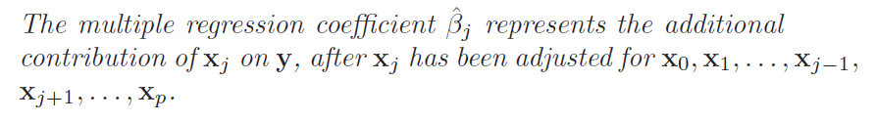
Linear methods for regression – Least square the simplest approach
Multiple Regression from Simple Univariate Regression
Notes:
If xp is highly correlated with some of the other xk’s, the residual vector
zp will be close to zero, and from (3.28) the coefficient ˆp will be very
unstable.

Slide 16
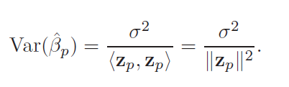
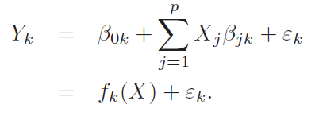
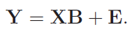
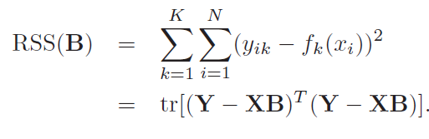
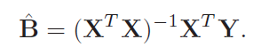
Linear methods for regression – Least square the simplest approach
Multiple Regression variance estimate
Multiple Outputs: Multiple outputs do not
affect one another’s least squares estimates.
the precision with which we can estimate B depends on
the length of the residual vector Z; if to variables are correlated this length is close to zero and our B estimate is unstable.
Notes:
Mult

Slide 17
Linear methods for regression – Least square the simplest approach
Subset Selection: why we don’t like least square
The first is prediction accuracy: the least squares estimates often have low bias but large variance. Prediction accuracy can sometimes be improved by shrinking or setting some coefficients to zero.
- The second reason is interpretation. With a large number of predictors, we often would like to determine a smaller subset that exhibit the strongest effects or variable selection.
Model selection : we are looking for models that reduce the number of variables or shrink them to zero, or both.

Slide 18
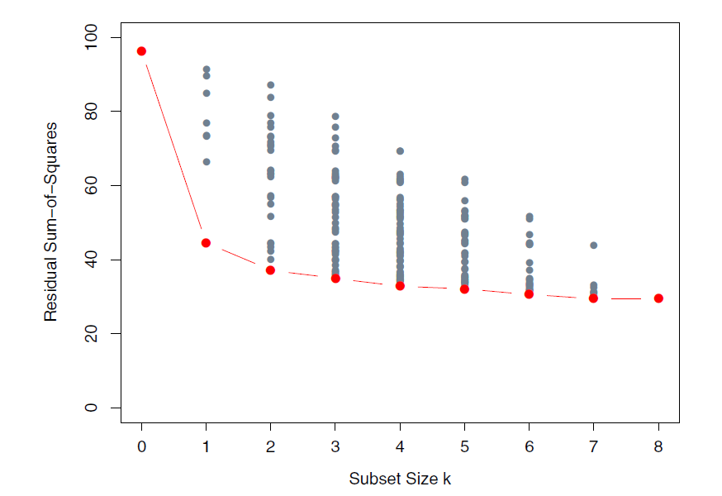
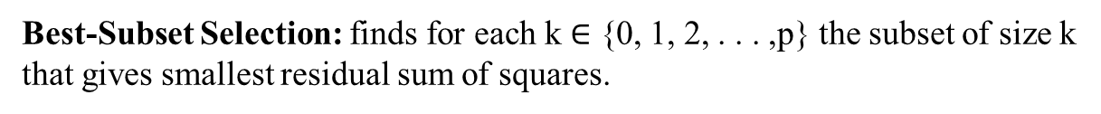
Linear methods for regression
Best-Subset Selection: finds for each k $∈$ {0, 1, 2, . . . ,p} the subset of size k
that gives smallest residual sum of squares.
Best algorithm in this family : leaps and bounds; up to 30-40 predictors.
The question of how to choose k involves the tradeoff between bias and variance, along with the more subjective desire for parsimony. Cross validation and AIC are popular techniques.

Slide 19
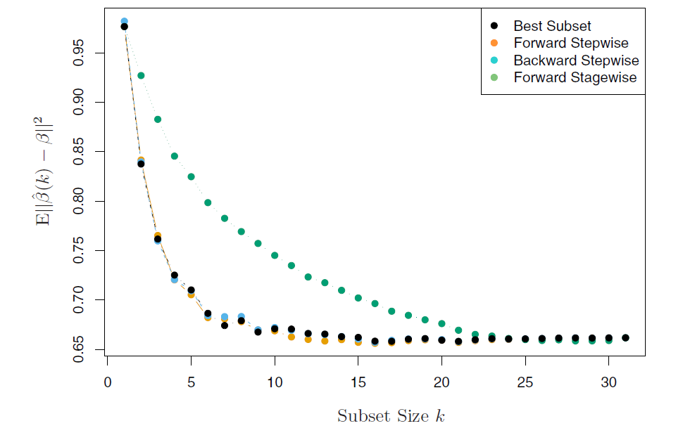
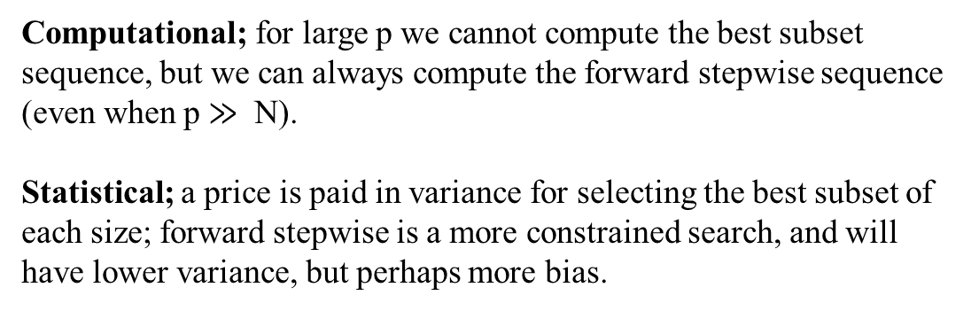
Linear methods for regression
Forward stepwise selection: starts with the intercept, and then sequentially adds into the model the predictor that most improves the fit
But it’s a greedy algorithm: always makes the choice that seems to be the best at that moment.
Computational; for large p we cannot compute the best subset sequence, but we can always compute the forward stepwise sequence (even when p $≫$ N).
Statistical; a price is paid in variance for selecting the best subset of each size; forward stepwise is a more constrained search, and will have lower variance, but perhaps more bias.

Slide 20
Linear methods for regression
Backward-stepwise selection: starts with the full model, and sequentially
deletes the predictor that has the least impact on the fit.
Hybrid: In R package the step function uses the AIC criterion for weighing the choices, which takes proper account of the number of parameters fit; at each step an add or drop will be performed that minimizes the AIC score.
Forward-Stagewise Regression: forget it, it has been dismissed long time ago! Because its inefficient.
Notes:
The candidate for dropping is the variable with the smallest Z-score.
Satgewise regression: It starts like forward-stepwise regression, with an intercept
equal to ¯y, and centered predictors with coefficients initially all 0.
At each step the algorithm identifies the variable most correlated with the
current residual. It then computes the simple linear regression coefficient
of the residual on this chosen variable, and then adds it to the current coefficient
for that variable. This is continued till none of the variables have
correlation with the residuals—i.e. the least-squares fit when N >p.

Slide 21
Linear methods for regression
Shrinkage Methods
By retaining a subset of the predictors and discarding the rest, subset selection produces a model that is interpretable and has possibly lower prediction error than the full model. However, because it is a discrete process— variables are either retained or discarded—it often exhibits high variance, and so doesn’t reduce the prediction error of the full model. Shrinkage methods are more continuous, and don’t suffer as much from high variability.

Slide 22



Linear methods for regression
Ridge Regression (Tikhonov regularization, weight decay): Ridge regression shrinks the regression coefficients by imposing a penalty on their size. It minimized a penalized residual sum of error:
- Here $λ≥0$ is a complexity parameter that controls the amount of shrinkage.
- the larger the value of λ, the greater the amount of shrinkage.
RMS
Penalty

Slide 23

Linear methods for regression
Why Ridge Regression works?
Notice the intercept term is out of the penalty term, which means its better to centralized our X, otherwise we might get different solution.
Assuming centering is done:
This adds a positive constant so X^{T}X is not singular anymore.

Slide 24



Linear methods for regression
Ridge Regression: singular value decomposition reveals the theoretical background of Ridge regression.
D is a p × p diagonal matrix, with diagonal entries d1 ≥ d2 ≥
· · · ≥ dp ≥ 0 called the singular values of X
This means that a greater amount of shrinkage
is applied to the coordinates of basis vectors with smaller d_{j}

Slide 25




Linear methods for regression
Ridge Regression: What does smaller d mean? Lets take a look at principal components of X
columns of V are also called the principal components directions of X. The first principal component direction V₁ has the property that Z₁ = XV₁ has the largest sample variance amongst all normalized linear combinations of the columns of X.
Var-Cov:
Hence the small singular values dj correspond to directions in the column space of X having small variance, and ridge regression shrinks these directions the most.
Notes:
eigen decomposition
-The implicit assumption is that the response will tend to vary most in the directions of high variance of the inputs. This is often a reasonable assumption, since predictors are
often chosen for study because they vary with the response variable, but need not hold in general.

Slide 26


Linear methods for regression

Slide 27


Linear methods for regression
L1 vs L2 norm
The Lasso regression
The Ridge regression
There is no closed form expression as in ridge regression (No analytical solution)
Notes:
L2 norm is replaced with L1 norm
In mathematics, an expression is said to be a closed-form expression if it can be expressed analytically in terms of a finite number of certain "well-known" functions.

Slide 28

Linear methods for regression
LASSO vs Ridge vs Subset selection
- Ridge regression does a proportional shrinkage. Lasso translates each coefficient by a constant factor , truncating at zero. This is called “soft thresholding”. Best-subset selection drops all variables with coefficients smaller than the M_{th} largest; this is a form of “hard-thresholding.” Thus Lasso does both Variable selection (by setting non-important to 0) and shrinkage.
The blue region is the acceptable region of solutions.
For the ridge regression intersect with axis is possible if the global minimum is also lies on the same axis (probability zero~ we don’t want that solution).
By increasing P>2 (rhomboid shape), there is more chance of zeros parameters in Lasso.
- Thus, L1 encourage sparsity (variable selection)
Notes:
Good intro: https://www.youtube.com/watch?v=sO4ZirJh9ds

Slide 29


Linear methods for regression
Elastic net regression: What about other norms?
The elastic-net selects variables like the lasso, and shrinks together the coefficients of correlated predictors like ridge

Slide 30
Linear methods for regression
Methods Using Derived Input Directions
- In many situations we have a large number of inputs, often very correlated. The methods in this section produce a small number of linear combinations Z_{m}, m = 1, . . . ,M of the original inputs X_{j} , and the Z_{m} are then used in place of the X_{j} as inputs in the regression.
- These methods are different in a way they construct the linear combinations.
- Two methods that we will discuss are PCR and PLSR.

Slide 31



Linear methods for regression
Principal Components Regression
Principal component regression forms the derived input columns Z_{m} = XV_{m}, and then regresses y on z1, z2, . . . , zM for some M > p. Since the z_{m} are orthogonal, this regression is just a sum of univariate regressions:
Remember this from multivariate regression!
Note that if M = p, we would just get back the usual least squares estimates, since the columns of
Z = UD span the column space of X.

Slide 32



Linear methods for regression
Principal Components Regression vs Ridge regression: One reminder all these regression techniques are related to
Each other!! Always remember that.

Slide 33
Linear methods for regression
Principal Components Regression vs Ridge regression:
- Ridge regression shrinks the coefficients of the principal components shrinking more depending on the size of the corresponding eigenvalue; principal components regression discards the p − M smallest
eigenvalue components.
-This means that ridge regression can be seen as a "smooth version" of PCR.

Slide 34

Linear methods for regression
Partial Least Squares
This technique also constructs a set of linear combinations of the inputs for regression, but unlike principal components regression it uses y (in addition to X) for this construction.
Like principal component regression, partial least squares (PLS) is not scale invariant, so we assume that each xj is standardized to have mean 0 and variance 1.

Slide 35


Linear methods for regression
PLSR vs PCR
partial least squares seeks directions that have high variance and have high correlation with the
response, in contrast to principal components regression which keys only on high variance
PCR
PLSR

Slide 36

Linear methods for regression
Discussion: A Comparison of the Selection and
Shrinkage Methods
PLS, PCR and ridge regression tend to behave similarly.
Ridge regression may be preferred because it shrinks smoothly, rather than in discrete steps
Lasso falls somewhere between ridge regression and best subset regression, and enjoys some of the properties of each.
for minimizing prediction error, ridge regression is generally preferable to variable subset selection, principal components regression and partial least squares.

Slide 37


Title

Slide 38

Linear classification methods

Slide 39
Title
Supervised learning
- Training data: {(x₁, g₁),(x₂, g₂), ...,(x_{N} , g_{N} )}
The feature vector X = (X₁,X₂, ...,Xp), where each variable X_{j} is quantitative.
The response variable G is categorical. G ∈ G = {1, 2, ...,K}
Form a predictor G(x) to predict G based on X

Slide 40

Title
Decision boundaries between two classes are linear (linear classification).
The decision boundary in two class problems are hyperplane, this can be generalized to multi class problems.
Question is what hyperplane to use?
Different criteria leads to different methods:
Linear regression of an indicator matrix
Linear discriminant anlysis
Logistics regression
Rosenblatt’s perceptron learning algorithm
Once again: The concepts of this chapter is the basis of more advanced linear-nonlinear methods discussed later
The left plot shows some data from three classes, with linear decision boundaries found by linear discriminant analysis. The right plot shows
quadratic decision boundaries. These were obtained by finding linear boundaries in the five-dimensional space X1;X2;X1X2;X21 ;X22 .

Slide 41
Title
Linear Regression of an Indicator Matrix: Clear your mind about regression then look at the matrix!
Here each of the response categories are coded via an indicator variable.
indicator response matrix (Y)
The predictor matrix (X)
pixel | x₁ | x₂ | x₃ | X₄
1 | 0 | 0 | 1 | 0
2 | 0 | 1 | 0 | 0
3 | 1 | 0 | 0 | 0
4 | 0 | 0 | 0 | 1
5 | 1 | 0 | 0 | 0
g | y₁ | y₂ | y₃ | y₄
3 | 0 | 0 | 1 | 0
2 | 0 | 1 | 0 | 0
1 | 1 | 0 | 0 | 0
4 | 0 | 0 | 0 | 1
1 | 1 | 0 | 0 | 0
The response variable is defined in matrix Y (indicator response matrix)
Y is a matrix of 0’s and 1’s with each row having a single 1.
For example row one is for pixel one from the training data that tell us this pixel is in class 3.
The i’th pixel of interest has covariate (predictors) values x_{i1}, . . . , x_{ip} that will be represented by X_{N×p}.
Goal
Goal is to find a linear model between X and Y.

Slide 42





Title
Linear Regression
Fit a linear regression model for each Y_{k} , k = 1, 2, ...,K, using X:
$\hat{y}$_{k} = X(X ^{T}X) ⁻¹X ^{T} y_{k}
Define Y = (y₁, y₂, ..., y_{k} ):
A new observation with input x is classified as follows:
compute the fitted output:
identify the largest component and classify accordingly:

Slide 43




Title
This is exactly same as minimizing the objective function:
There is a serious problem with the regression approach when the number of classes K ≥3, especially prevalent when K is large. Because of the rigid nature of the regression model, classes can be masked by others.
The rigid nature of linear regression totally missed the middle class. This is called masking problem.
A loose but general rule is that if K ≥ 3 classes are lined up, polynomial terms up to degree K-1 might be needed to resolve them.
This is an extreme case, but more realistically it happens when K > p.

Slide 44
Title
Linear Discriminant Analysis:
We assume that n objects have been measured for m characteristics (variables), and that the objects originate from k different groups. Suppose that the groups consist of n₁,..., n_{k} objects, where n₁ + n₂ +… + n_{k} = n. There are two different approaches to derive a rule for discrimination between the groups, the BAYESIAN and the FISHER approach

Slide 45



Title
Bayes Discriminant Analysis
For the BAYESIAN DISCRIMINANT RULE, an underlying data distribution f_{k} for each group k = 1, . . . , k is required, which is usually assumed to be a multivariate normal distribution with mean $μ_{k}$ and covariance $\sum_{k}{}$:
Moreover, we assume that there exists a certain PRIOR PROBABILITY $π_{i}$ for each group, and $π_{1}+π_{2}+…π_{k}=1$
The Bayesian rule uses the POSTERIOR PROBABILITY P(l|x) that an object x belongs to group l, which is given by:
Observation x will be assigned to that group for which the posterior probability is the largest and since the denominator is the same for all classes, the decision boundary between two classes h and l is given by objects x for which the posterior probabilities are equal, i.e., P(h|x) = P(l|x).

Slide 46



Title
Bayes Discriminant Analysis
An object x will be assigned to that group where the density function f_{j}(x) is the largest
Maximizing the posterior probabilities in case of multivariate normal densities will result in quadratic or linear discriminant rules. However, the rules are LINEAR if we use the additional assumption that the covariance matrices of all groups are equal, i.e.,
$\sum_{k}{= \sum{}}$:

Slide 47

Title
Pay attention to the assumption of the same covariance (left panel).
The left panel shows three Gaussian distributions, with the same covariance and different means. Included are the contours of constant density enclosing 95% of the probability in each case. The Bayes decision boundaries between each pair of classes are shown (broken straight lines), and the Bayes decision boundaries separating all three classes are the thicker solid lines (a subset of the former). On the right we see a sample of 30 drawn from each Gaussian distribution, and the fitted LDA decision boundaries.

Slide 48


Title
In practice we do not know the parameters of the Gaussian distributions,
and will need to estimate them using our training data:
If the assumption of $\sum_{k}{= \sum{}}$ is not assumed, then we are dealing with quadratic discriminant function

Slide 49

Title
Two methods for fitting quadratic boundaries. The left plot shows the quadratic decision boundaries for the data in Figure 4.1 (obtained using LDA in the ve-dimensional space X1;X2;X1X2;X21 ;X22 ). The right plot shows the quadratic decision boundaries found by QDA. The differences are small, as is usually the case.

Slide 50
Title
Conclusion on LDA and QDA:
Both methods are surprisingly good in many applications!
The reason is not likely to be that the data are approximately Gaussian, and in addition for LDA that the covariances are approximately equal. More likely a reason is that the data can only support simple decision boundaries such as linear or quadratic, and the estimates provided via the Gaussian models are stable.
This is a bias variance tradeoff . We can put up with the bias of a linear decision boundary because it can be estimated with much lower variance than more exotic alternatives.

Slide 51
Title
Regularized Discriminant Analysis (Continue later…)

Slide 52
Model Assessment and Selection
Model Assessment and Selection
The generalization performance of a learning method relates to its prediction capability on independent test data.

Slide 53




Model Assessment and Selection
Bias-Variance tradeoff
Suppose we have a target variable Y , a vector of inputs X, and a prediction model f(X) that has been estimated from a training set $𝒯$
Typical choices of error are:
Test error, also referred to as generalization error, is the prediction error over an independent test sample or:
As the model becomes more and more complex, it uses the training data more and is able to adapt to more complicated underlying structures. Hence there is a decrease in bias but an increase in variance.
Blue: training set, red: Test set, regression: LASSO

Slide 54

Model Assessment and Selection
Model selection: estimating the performance of different models in order to choose the best one.
Model assessment: having chosen a final model, estimating its prediction error (generalization error) on new data.
Best practice:
Split data into training, validation and test. The training set is used to t the models; the validation set is used to estimate prediction error for model selection; the test set is used for assessment of the generalization error of the final chosen model.
50%
25%
25%

Slide 55




Model Assessment and Selection
The Bias-Variance Decomposition
- we assume that $Y=f\left(x\right)+ ε$ where E($ε$) = 0 and Var($ε$) = $σ_{ε}^{2}$
- we can derive an expression for the expected prediction error of a regression fit $\hat{f}(X)$ at an input point X = x0, using squared-error loss:
- The first term is the variance of the target around its true mean $f(x_{0})$, and
cannot be avoided no matter how well we estimate $f(x_{0})$, unless $σ_{ε}^{2}=0$.
- The second term is the squared bias, the amount by which the average of
our estimate differs from the true mean
- the last term is the variance; the expected squared deviation of $\hat{f}(x_{0})$ around its mean.

Slide 56






Model Assessment and Selection
Suppose a linear model with p components:
Then the error is:
Here h is:
the N-vector of linear weights that produce the fit:
And hence:
Model complexity contribute
to variance
While this variance changes withX₀, its average (with X₀ taken to be each of the sample values X_{i}) is (p/N) $σ_{ε}^{2}$, and hence

Slide 57



Model Assessment and Selection
For the ridge regression everything is the same except the h now has the form:
The first term on the right-hand side is the average squared model bias, the error between the best-fitting linear approximation and the true function.
The second term is the average squared estimation bias, the error between the average estimate and the best-fitting linear approximation.

Slide 58



Model Assessment and Selection
Optimism of the Training Error Rate
Given a training set:
The generalization error rate of new points (X⁰ , Y⁰) for model $\hat{f}$ is:
Averaging over training sets $𝒯$ yields the expected error
Now typically, the training error
A fitting method typically adapts to the training data, and hence the apparent or training error Err will be an overly optimistic estimate of the generalization error Err$𝒯$.

Slide 59



Model Assessment and Selection
In-sample error vs training error and optimization: the amount by which E_{rr} underestimates the true error depends on how strongly y_{i} affects its own prediction.
In general the:
In-sample error = Training error + optimism
I sample error is defined as:
Note, Y⁰ in this setup has random part, e.g. with additive error ε∼N(0,σ2ε). So for fixed (x,y)∈T, new response Y⁰ to the predictor x needs not to be the same.
Now optimism is defined as:
Opt = Err_{in} - $opt= {Err}_{in}−\overline{Err}$
Finally, the average optimism is the expectation of the optimism over training sets.

Slide 60


Model Assessment and Selection
In-sample error vs training error and optimization: the amount by which E_{rr} underestimates the true error depends on how strongly y_{i} affects its own prediction.
One can show:
Where d is the number of paramters
The harder we fit the data, the greater Cov(y_{i}; y_{i}) will be, thereby increasing the optimism.

Slide 61




Model Assessment and Selection
Estimates of In-Sample Prediction Error: Akaike information criterion
when d parameters are fit under squared error loss, leads to a version of the so-called Cp statistic,
The Akaike information criterion is a similar but more generally applicable estimate of Errin when a log-likelihood loss function is used.
The general form of AIC is
The AIC penalizes large models by the additive term 2m (model paramters)
Notes:
Form of th eAIC depends on the type f the loss function.

Slide 62

Model Assessment and Selection
The Bayesian Approach and BIC
Therefore BIC is proportional to AIC (Cp ), with the factor 2 replaced by log N.
If the number of objects N > 7, log N is larger than 2, and BIC gives more penalty to larger models than AIC. In other words, BIC usually selects smaller models than AIC.
BIC rooted in Bayesian statistics as its name implies! It can be shown choosing the model with minimum BIC is equivalent to choosing the model with largest (approximate) posterior probability.

Slide 63

Model Assessment and Selection
Cross-Validation: the most simplest and widely used method
This method directly estimates the expected extra-sample error, unlike AIC and BIC that we measure level of optimism.
K-Fold Cross-Validation
Split data into k group
Put a side one group as validation
Calibrate your model
Validate it
Go to the next validation set
The case K = N is known as leave-one-out cross-validation

Slide 64

Model Assessment and Selection
What value should we choose for K?
With K = N, the cross-validation estimator is approximately unbiased for the true (expected) prediction error, but can have high variance because the N “training sets" are so similar to one another.
On the other hand, with K = 5 say, cross-validation has lower variance. But bias could be a problem, depending on how the performance of the learning method varies with the size of the training set.
- In the figure orange is CV and blue is prediction error.
- For most cases 10-fold is a good choice.

Slide 65
Model Assessment and Selection
Bootstrap Methods
Basic ideas of bootstrap are RESAMPLING WITH REPLACEMENT, and to use calibration sets with the same number of objects, n, as objects are in the available data set.
Resampling with replacement means, a calibration set is obtained by selecting randomly objects and copying (not moving) them into the calibration set. After n selections, the calibration set is ready and has properties as follows:
Contains n objects
Some objects are represented repeatedly
Some objects from the available data have not been selected
- The resulting optimized model is then applied to the objects not contained in the calibration set giving predicted values

Slide 66
Title
Additive Models, Trees, and Related Methods

Slide 67
Title
Let pause a minute and get back to our linear model y=B₁+B₂X+error
Y= constant + coefficient 1 × X₁ ….+ coefficient 2 × X₂….
Coefficients link the predictors to Y
Linear means non of the parameters are exponents or divided/multiplied by another parameter

Slide 68


Title
Generalized Additive Models: When linearity is a wrong assumption we use non-linear models and we call them
Generalized additive models (this is way more complicated than these two slides!!)
General form:
As usual X is predictor matrix and f_{p}(X_{p}) are unspecified smooth (“nonparametric") functions.
In general, the conditional µ(X) of a response Y is related to an additive function of the predictors via a link function g(µ), traditionally there are three different link functions
Notes:
Link function arises due to different assumptions

Slide 69



Title
The general form:
penalized sum of squares:
Backfitting algorithm:
Smooth = smoothing operator (usually
Cubical spline)

Slide 70
Title
In summary:
GAM extends the linear models to non-linear cases
GAM is not designed for large data mining application. Although some variable selection is added to it later, still don’t use it.

Slide 71


Title
Tree-Based Methods: Tree-based methods partition the feature space into a set of rectangles, and then
fit a simple model (like a constant) in each one. Let start with the simplest tree based model CART
Suppose we have response Y with two predictors X1 and X2:
- In tree based methods we split the feature space and assign a constant C_{i} which is the mean of Y_{i}’s in that region.
We first split the space into two regions, and model the response by the mean of Y in each region.
Then one or both of these regions are split into two more regions, and this process is continued…
C₂=mean(y_{i}’s)
C₄=mean(y_{i}’s)
So the regression function for this problem is:

Slide 72

Title
Its easier to show in tree format, specially when the number of predictors are greater than 2

Slide 73



Title
What Are Regression Trees, How to Grow them?
As usual our data is (x_{i},y_{i}) for i = 1,2,…., N with x_{i} = x_{i1},x_{i2}…x_{ip}.
The algorithm needs to automatically decide on the splitting variables and split points, and also what topology (shape) the tree should have.
Suppose first that we have a partition into M regions R₁;R₂;…;R_{M.}
Then as we saw before:
If we adopt as our criterion minimization of the sum of squares $\sum_{m=1}^{M}{{(y_{i}−f(x_{i}))}^{2}}$, it is easy to see that the best $\hat{C_{m}}$ is just the average of y_{i} in region R_{m}:

Slide 74

Title
How to find the split point? The greedy algorithm
1-Starting with all of the data, consider a splitting variable j and split point s, and define the pair of half-planes
2-Then we seek the splitting variable j and split point s that solve:
3-For any choice j and s, the inner minimization is solved by:
4- Repeat 1-3 on all of the resulting regions.

Slide 75
Title
How big should be the tree?
Clearley a big tree overfit the data and small tree doesn’t capture the structure of the data.
The size of the tree is the model complexity similar to λ in Ridge regression or number of PC in PCA and PLSR
Some approaches are:
split tree nodes only if the decrease in sum-of-squares due to the split exceeds some threshold.
This strategy is too short-sighted, however, since a seemingly worthless split might lead to a very good split below it.
The preferred strategy is to grow a large tree T₀, stopping the splitting process only when some minimum node size (say 5) is reached. Then this large tree is pruned using cost-complexity pruning, which we now describe.

Slide 76




Title
cost-complexity pruning
We define a subtree $T ⊂ T_{0}$ to be any tree that can be obtained by pruning T, that is, collapsing any number of its internal (non-terminal) nodes.
We index terminal nodes by m, with node m representing region R_{m}. Let |T| denote the number of terminal nodes in T.
we define the cost complexity criterion:
The idea is to find, for each α, the subtree $T_{∝}⊆T_{0}$ to minimize C_{α}(T).
Large values of result in smaller trees

Slide 77

Title
Issues
Categorical Predictors
When splitting a predictor having q possible unordered values, there are 2^{q-1} -1 possible partitions of the q values into two groups, and the computations become prohibitive for large q.
Why Binary Splits?
The problem is that multiway splits fragment the data too quickly, leaving insufficient data at the next level down
Linear Combination Splits
Rather than restricting splits to be of the form Xj <=s, one can allow splits along linear combinations of the form $\sum{a_{j}x_{j}}≤s$. While this can improve the predictive power of the tree, it can hurt interpretability.
Instability of Trees
One major problem with trees is their high variance. Often a small change in the data can result in a very different series of splits, making interpretation somewhat precarious. Bagging averages many trees to reduce this variance
Lack of Smoothness

Slide 78
Title
Hierarchical Mixtures of Experts
- The hierarchical mixtures of experts (HME) procedure can be viewed as a variant of tree-based methods. The main difference is that the tree splits are not hard decisions but rather soft probabilistic ones.
In an HME, a linear (or logistic regression) model is t in each terminal node, instead of a constant as in CART.
By using soft splits rather than hard decision rules it can capture situations where the transition from low to high response is gradual.
The emphasis in the research on HMEs has been on prediction rather than interpretation of the final model (Stay away from this!)

Slide 79
Title
Missing Data
It is quite common to have observations with missing values for one or more input features. The usual approach is to impute (fill-in) the missing values in some way.
However, the first issue in dealing with the problem is determining whether the missing data mechanism has distorted the observed data
Discard observations with any missing values.
Rely on the learning algorithm to deal with missing values in its training phase.
Impute all missing values before training.

Slide 80

Title
Model Inference and Averaging

Slide 81





Title
The Bootstrap and Maximum Likelihood Methods-A Smoothing Example
As always our data looks like $Z_{i}=(x_{i},y_{i})$ and y_{i} can be categorical (classification) or continues (regression).
Suppose we decide to fit this with 7 spline
function:
Now we can estimate Cov matrix
and confidence interval…
Where µ(x) represents E(Y|X=x) or simply Y
Then similar to linear regression:
With the exception that H are functions
Notes:
Spline belong to family of Basis Expansions and Regularization regression analysis.

Slide 82



Title
The seven functions (splines)
Smoothed model
Confidence intervals

Slide 83



Title
Now lets apply bootstrapping to the previous example:
-We draw B datasets each of size N = 50 with replacement from our training data
To each bootstrap dataset Z* we fit a cubic spline $\hat{μ^{∗}}$.
Using B = 200 bootstrap samples, we can form a 95% pointwise confidence band from the percentiles at each x
We find the 2:5%*200 = fifth largest and smallest values at each x
Bootstrap confidence
interval for B=200
Confidence interval
from least square
B=10
Very similar

Slide 84
Title
Relationship between bootstring and least square estimates
The bootstrap method described above, in which we sample with replacement from the training data, is called the nonparametric bootstrap. This really means that the method is “model-free“
On the other hand we have a parametric bootstrapping and as sampling goes to infinity it can be proven the confidence interval is exactly the least square estimate.

Slide 85



Title
Maximum Likelihood Inference
We begin by specifying a probability density or probability mass function for our observations:
Where θ is the one or more unknown parameters for Z. For example if Z has a normal distribution with
mean µ and variance $σ^{2}$and:
Maximum likelihood is based on the likelihood function
the probability of the observed data under the model g _{θ}

Slide 86





Title
Denote the logarithm of L(θ;Z) by:
This expression is called the log-likelihood, and each value $ℓ\left(θ, z_{i}\right)=\log{g_{θ}\left(z_{i}\right)}$ is called the log likelihood components. The method of maximum likelihood chooses the value $θ$= $\hat{θ}$ to maximize $ℓ\left(θ, z_{i}\right)$.
The score function is defined by:
Or

Slide 87




Title
The information matrix
The Fisher information (or expected information) is
Finally, let 𝜃₀ denote the true value of $θ$.
Then the confidence interval is:
Notes:
Fisher information (sometimes simply called information is a way of measuring the amount of information that an observable random variable X carries about an unknown parameter θ of a distribution that models X. Formally, it is the variance of the score, or the expected value of the observed information

Slide 88
Title
Bootstrap versus Maximum Likelihood
In essence the bootstrap is a computer implementation of nonparametric or parametric maximum likelihood. The advantage of the bootstrap over the maximum likelihood formula is that it allows us to compute maximum likelihood estimates of standard errors and other quantities in settings where
no formulas are available.

Slide 89

Title
Bayesian Methods
sampling model (density or probability mass function; likelihood)
prior distribution for the parameters
posterior distribution
which represents our updated knowledge about after we see the data
The goal of Bayesian approaches is to maximize the likelihood function. Different algorithm:
- Gibbs sampling
- EM algorithm
- MCMC

Slide 90

Title
The Bayesian approach differs from the standard (“frequentist") method for inference in its use of a prior
distribution to express the uncertainty present before seeing the data, and to allow the uncertainty remaining after seeing the data to be expressed in the form of a posterior distribution
The posterior distribution also provides the basis for predicting the values of a future observation z^{new}, via the predictive distribution:

Slide 91

Title
Smoothing example: Ten draws from the posterior distribution for the function µ(x), for two different values of the prior variance t. The purple curves are the posterior means.

Slide 92

Title
Bagging (Wisdom of Crowds)
Here we use bootstrapping to improve the predictions
Bagging can dramatically reduce the variance (bias unchanged) of unstable procedures like trees, leading to improved prediction
As usual suppose we fit a model, $\hat{f}(x)$ to our data Z:
Bootstrap aggregation or bagging averages this prediction over a collection of bootstrap samples, thereby reducing its variance.
For each bootstrap sample $Z^{∗b}$, b=1,2,…,B; we t our model, giving prediction ${\hat{f}}^{∗b}(x)$
The bagging estimate is defined by:

Slide 93

Title
The bagged estimate will differ from the original estimate $\hat{f}(x)$ only when the latter is a nonlinear or adaptive function of the data.
Lets get back to regression trees (we are close to RF!)
Remember:
Each bootstrap tree will typically involve different features than the original, and might have a different number of terminal nodes, The bagged estimate is the average prediction at x from these B trees in regression or the most “vote” in classification.

Slide 94


Title
More on bagging in classification: what is/why majority vote?
the bagged estimate for classification tree, ${\hat{f}}_{bag}(x)$, is a k-vector $p_{1}\left(x\right),p_{2}\left(x\right),…,p_{k}(x)$ with $p_{k}(x)$ is the proportion
of trees voting for class k. The bagged classifier selects the class with the most “votes" from the B
trees:
Question: $p_{sagebrush}\left(NDVI=0.26\right)=0.75$, can we say the sagebrush class probability at NVDI=0.26 is 0.75? In another word the if NDVI is 0.26 there is 75% chance that the pixel is sagebrush?
Answer: NO! It is tempting to treat the voting proportions $p_{k}(x)$ as estimates of these probabilities but a simple two class example shows that they fail in this regard.
A simple two-class example shows that they fail in this regard. Suppose the true probability of class 1 at x is
0:75, and each of the bagged classifiers accurately predict a 1. Then $p_{1}(x)$ , which is incorrect.

Slide 95
Title
In summary:
We can understand the bagging effect in terms of a consensus of independent weak learners.
bagged tree is no longer a tree. For interpretation of the model this is clearly a drawback.
If instead of taking mean in bagging we chose the model that best fit the observation the method is called Bumping. Its suitable when we have too many local minima.
If we assign weights and then take the average the technique is called Gradient Boosting, which in many cases outperform bagging. In Boosting we try to remove bias as well.
Final word: Wisdom of crowd: the collective knowledge of a diverse and independent body of people typically exceeds the knowledge of any single individual, and can be harnessed by voting. Its debatable tho, there are cases where, let say bagging, worsen the results!
Notes:
For many classifiers G(x), however, there is already an underlying function ^ f(x) that estimates the class probabilities at x (for
trees, the class proportions in the terminal node).

Slide 96

Title
Random Forest

Slide 97


Title
Introduction
Random forests is a substantial modification of bagging that builds a large collection of de-correlated trees, and then averages them.
Since trees are notoriously noisy, they benefit greatly from the averaging (Bagging).
Bagging reduces the variance with a factor of $\frac{1}{B}σ^{2}$ (bias is untouched) if the variables are iid.
If the variable are correlated with correlation $ρ$ then the variance reduction factor is :
As B increases, the second term disappears, but the first remains, and hence the size of the correlation of pairs of bagged trees limits the benefits of averaging

Slide 98

Title
Idea
The idea in random forests is to improve the variance reduction of bagging by reducing the correlation between the trees, without increasing the variance too much. This is achieved in the tree-growing process through random selection of the input variables.
Before each split, select m ≤ p of the input variables at random as candidates for splitting.
Very similar to bagging!
Where $Θ_{b}$characterizes the b’th random forest tree in terms of split variables, cutpoints at each node, and terminal-node values.

Slide 99

Title

Slide 100

Title
The authors make grand claims about the success of random forests: “most accurate,“ and “most interpretable,“
Boosting might outperform RF but with much slower computation.

Slide 101


Title
Details of Random Forests
Inventors make the following recommendations:
For classification, the default value for m is $\sqrt{p}$ and the minimum node size is one.
For regression, the default value for m is p/3 and the minimum node size is five.
In practice the best values for these parameters will depend on the problem, and they should be treated as tuning parameters.
In this figure, the m = 6 performs much better than the default value $\left\lfloor 8/3\right\rfloor =2$.

Slide 102

Title
Out of Bag Samples
During the bootstrapping a proportion of observation is not included in construction of Random Forest, those samples are called the out of bag samples.
We use out of bag samples to estimate error of associated RF, this error is called out of bag error (OOB).
In concept it is almost identical to cross validation.

Slide 103

Title
Variable Importance
At each split in each tree, the improvement in the split-criterion is the importance measure attributed to the splitting variable, and is accumulated over all the trees in the forest separately for each variable.
Different measures can be used, e.g. Gini index or OOB.

Slide 104

Title
Proximity plot
- proximity plot gives an indication of which observations are effectively close together in the eyes of the random forest classifier.
- Looks tempting to use them for classification!
Proximity plots for random forests often look very similar, irrespective of the data, which casts doubt on their utility. They all have somehow star shape!

Slide 105

Title
Random Forests and Over fitting
When the number of variables is large, but the fraction of relevant variables small, random forests are likely to perform poorly with small m.
Another claim is that random forests “cannot overfit" the data. This is not true!
The average of fully grown trees can result in too rich a model, and incur unnecessary variance

Slide 106
Title
Analysis of Random Forests
LATER!

